Slide 1
SQL SERIES- ZERO TO HERO- DAY 1
Devikrishna r

Slide 2
What we will cover today?
What is Data?
What is a Database ?
What is DBMS[Database Management System]?
What is RDBMS[Database Management System]?
What is SQL ?
What is a Table and fields?
What is Primary Key?
What is Unique Key?
What is Foregine Key?
Difference Between Spreadsheets and DataBase?

Slide 3
What we will cover today?
Relational vs Non-Relational DB vs Cloud Database?
What are SQL Commands?
Explain types of SQL Commands?

Slide 4
What is Data?
Data can be facts related to any object in consideration. For example, your name, age, height, weight, etc. are some data related to you. A picture, image, file, pdf, etc

Slide 5
What is a Database?
A database is a systematic collection of data. They support storage and manipulation of data. Databases make data management easy.
Let us discuss a database example:
An online telephone directory
Facebook [ It needs to store, manipulate, and present data related to members, their friends, member activities, messages, advertisements, and a lot more. ]

Slide 6
What is DBMS?
Database Management System.
What is DBMS? Database Management System (DBMS) is a software [It consist of programs]
Database Management System (DBMS) is a collection of programs that enable its users to access databases, manipulate data, report, and represent data. It also helps to control access to the database.

Slide 7
What is RDBMS [Database Management System]?
RDBMS store data into a collection of tables, which is related by common fields between the columns of the table. It also provides relational operators to manipulate the data stored into the tables.
Example: SQL Server.

Slide 8
What is SQL ?
SQL stands for Structured Query Language.
It is used to communicate with the Database.
This is a standard language used to perform tasks such as retrieval, updates, insertion and deletion of data from a database.
Standard SQL Commands are Select.

Slide 9
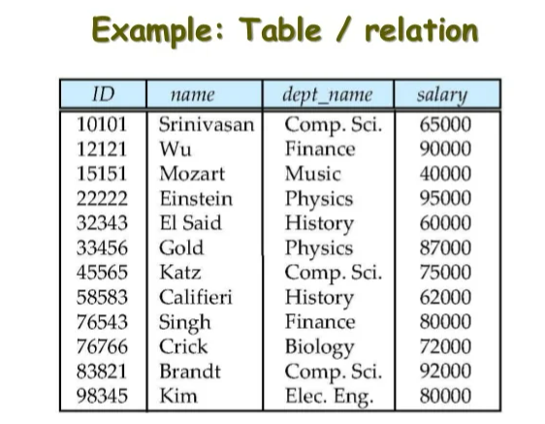
What is a Table and fields ?
A database table is a structure that organizes data into rows and columns with some relations.
Example: Data arranged in a spreadsheet.
A table has a specified number of
columns called fields but can have any number of rows that are called records.
Example:
Table: Employee.
Field: ID, Name,dept_name,salary.
Data: 10101, Srinivasan,Comp.Sci,65000.

Slide 10
What is primary key?
A primary key is a combination of fields that uniquely specify a row. This is a special kind of unique key.
it has implicit, NOT NULL constraint. This means Primary key values cannot be NULL.

Slide 11
What is a unique key?
A Unique key constraint uniquely identifies each record in a database.
This provides uniqueness for the column or set of columns.
A Primary key constraint has automatic unique constraint defined on it.
There can be many unique constraints defined per table, but only one Primary key
constraint defined per table.

Slide 12
What is a foreign key?
A foreign key is one table which can be related to the primary key of another table.
Relationships need to be created between two tables by referencing the foreign key with the primary key of another table.

Slide 13
Difference Between Spreadsheets and DataBase?
SpreadSheets:
A file that exists of cells in rows and columns and can help arrange, calculate and sort data.
It can have numeric values, text, formulas, and functions.
It features columns and rows to keep inserted information legible and simple to understand.
It is an electronic graph sheet.
Database:
It is an organized collection of data arranged for ease and speed of search and retrieval.
It contains multiple tables.
a database engine can sort, change or serve the information on the database.
Basically, it is a set of information that is held in a computer.

Slide 14
Relational vs Non-Relational DB?
Relational Database:
A relational database is made up of a set of tables with data that fits into a predefined category. It has some relationships.
SQL server
MySQL
PostgreSQL
Maria DB
Sql lite

Slide 15
Non-Relational Database: Mongo DB, Cassandra
NoSQL (Not Only SQL), is any kind of database that doesn’t use the tables, fields, and columns structured data concept from relational databases.
Non-relational databases have been designed with the cloud in mind, making them great at horizontal scaling.
Four main types of NoSQL databases:
Document databases →Stores data in JSON, BSON, or XML documents
Key-value stores → Data stored as a key value pair [attribute name ("key") and a value].
Column-oriented databases→Columnar databases can quickly aggregate the value of a given column
Graph databases →relationship between data elements. Each element is stored as a node (such as a person in a social media graph). The connections between elements are called links or relationships

Slide 16
Cloud Database:
A cloud database is a database that typically runs on a cloud computing platform. Database service provides access to the database. Database services make the underlying software stack transparent to the user.
Microsoft Azure SQL Database
Amazon Relational Database Service
Google Cloud SQL
IBM Db2 on Cloud
Oracle Database
Google BigQuery
Amazon Redshift

Slide 17
What are SQL Commands?
1. DDL - Data Definition Language
2. DQL - Data Query Language
3. DML - Data Manipulation Language
4. DCL - Data Control Language
5. TCL – Transaction Control Language.

Slide 18
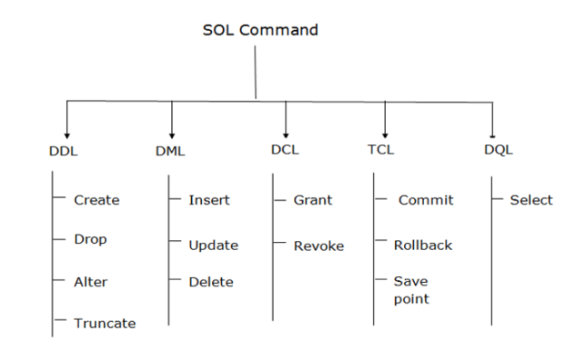

Slide 19
a. DDL(Data Definition Language):
SQL commands that can be used to define the database schema.
It simply deals with descriptions of the database schema and is used to create and modify the structure of database objects in the database.
Examples of DDL commands:
CREATE - is used to create the database or its objects (like table, index, function, views, store procedure, and triggers).
DROP - is used to delete objects from the database.
ALTER -is used to alter the structure of the database.
TRUNCATE–is used to remove all records from a table, including all spaces allocated for the records are removed.
COMMENT –is used to add comments to the data dictionary.

Slide 20
b. DQL (Data Query Language) :
DML statements are used for performing queries on the data within schema objects.
The purpose of the DQL Command is to get some schema relation based on the query passed to it.
Example of DQL:
SELECT – is used to retrieve data from the database.

Slide 21
c.DML(Data Manipulation Language):
The manipulation of data present in the database belong to DML or Data Manipulation Language and this includes most of the SQL statements.
Examples of DML:
INSERT – is used to insert data into a table.
UPDATE - is used to update existing data within a table.
DELETE – is used to delete records from a database table.

Slide 22
d.DCL(Data Control Language) :
DCL includes commands such as GRANT and REVOKE which mainly deal with the rights, permissions, and other controls of the database system.
Examples of DCL commands:
GRANT -gives user access privileges to the database.
REVOKE-withdraw user's access privileges given by using the GRANT command.

Slide 23
e.TCL(transaction Control Language):
TCL commands deal with the transaction within the database.
Examples of TCL commands:
COMMIT– commits a Transaction.
ROLLBACK– rollbacks a transaction in case of any error occurs.
SAVEPOINT –sets a savepoint within a transaction.
SET TRANSACTION –specify characteristics for the transaction.

